Slide 1
NSTEMI: risk stratification and management
Kshitij S. Mavade

Slide 2
Defination
Features that help differentiate ACS from stable angina are
(1) onset of symptoms at rest (or with minimal exertion) and lasting longer than 10 minutes unless treated promptly;
(2) severe, oppressive pressure or chest discomfort; and
(3) an accelerating pattern of symptoms that develop more frequently, occur with greater severity, or awaken the patient from sleep

Slide 4
Clinical Assessment
Physical examination / clinical history
Electrocardiogram
Cardiac biomarkers
Risk stratification
Further investigations

Slide 5
History
NSTE-ACS most commonly presents as a pressure-type chest pain that typically occurs at rest or with minimal exertion lasting ≥10 minutes
Relatively uncommon in men <40 yr. and women < 50 yr
Previous history of coronary heart disease(CHD)
Presence of traditional risk factors for CHD.

Slide 6
Atypical manifestations :”anginal equivalents”- more prevalent in women, older adults, patients with DM2, CKD or Dementia.
Unexplained new-onset or increased exertional dyspnea is the most common angina equivalent
Secondary NSTE ACS :cause is extrinsic to coronaries
Increase in myocardial O2 demand: fever, tachycardia, hypertensive emergencies
Decrease in supply: hypotension, anemia

Slide 7
Pysical examianation
May be normal
Audible S3 and/or S4
Hypotension, pale cool skin, cardiogenic shock
To r/ o other non coronary cardiac cause/noncardiac cause

Slide 8
ECG
A 12-lead ECG should be performed and interpreted within 10 minutes of the patient’s arrival at an emergency facility to assess for cardiac ischemia or injury.
Changes include ST depression, transient ST-elevation, or new T-wave inversion
Significant changes: 0.05mV ST Depression compare to recent ECG (In PURSUIT trial 30 day mortality was 5.1% in patient with ST depression compared to 2.1% in patient without ST depression)
Deep T wave inversion of >0.2mV
Transient ST elevation lasting for <20 min

Slide 9
A normal ECG does not exclude ACS and occurs in 1% to 6% of such patients.
A normal ECG may also be associated with left circumflex or right coronary artery occlusions, which can be electrically silent.
posterior electrocardiographic leads [V7 to V9] may be helpful. Right-sided leads (V3R to V4R)
Left ventricular (LV) hypertrophy, bundlebranch blocks with repolarization abnormalities, and ventricular pacing may mask signs of ischemia/injury.
ECG should be repeated (e.g., at 15- to 30-minute intervals during them first hour), especially if symptoms recur

Slide 10
biomarkers
Cardiac troponins are the most sensitive and specific biomarkers for NSTE-ACS.
Even minor elevation in cTn levels associated with poor outcome.
Diagnosis of acute MI requires an elevation in cTnI or cTnT above the 99th percentile of the normal range for the specific assay used, a typical temporal rise and decline when serial samples are tested, and a clinical picture consistent with ACS.
A negative cardiac troponin obtained with more sensitive cardiac troponin assays on admission confers a >95% negative predictive value for MI compared with high-sensitivity assays that confer a negative predictive value ≥99%

Slide 11
Newer high-sensitivity assays can, exclude myocardial necrosis if two values measured 3 hours apart are both normal.
The fourth-generation cTn assays are less sensitive than the so-called high-sensitivity assays, and two negative cTn assays at least 6 to 9 hours apart are needed to exclude MI.

Slide 12
Causes of troponin elevation other than ACS
Pulmonary embolus
myocarditis
Cardiac contusion
Congestive heart failure
Chemiotherapy (adiramycin, 5-flurouracil)
Cardioversion or RFA
Septic shock
Extreme endurance athletics
Renal failure

Slide 13
Pro-BNP & NT-Pro BNP
No diagnostic, but prognostic significance.
rise in proportion to the degree of ventricular distention and correlate with the risk for adverse events
In patients with NSTE-ACS, a baseline BNP measured on average 40 hours after the onset of symptoms correlated strongly with risk for death, heart failure, and MI through 10 months in a graded fashion.

Slide 14
CRP & other biomarkers
C-reactive protein (CRP) is a marker of inflammation that is elevated following ACS, and persistently elevated levels after discharge are associated with increased long-term cardiovascular risk.
CRP provides less prognostic information than cTn & Pro BNP, routine CRP measurement after ACS is not recommended.
Others , if elevated shows increased chances of CV events in both short and long terms e.g.
Blood sugar level
HbA1c
Markers for renal dysfunctions- cystatin c, serum creatinine

Slide 15
Emerging biomarkers
Markers that predict death and/ ischemic events
Growth differentiation factor 15 (GDF 15)
Heart-type fatty acid binding protein (H-FABP)
myeloperoxidase
Pregnancy associated plasma protein A (PAPP-A)- expressed in eroded and ruptured plaque
Placental growth factor
Secretory phospholipase A2
Interleukin-6 (IL-6)
Chemokine ligand-5 & ligand 18
Markers that predict heart failure
Midregional proadrenomedullin
neopterin
osteoprotegrin

Slide 16
ECHO
useful in the assessment of left ventricular systolic and diastolic function
left atrial dilation, functional mitral regurgitation, tricuspid annular plane systolic excursion, diastolic dysfunction, ventricular mechanical dyssynchrony, and ultrasound lung comets
Each of which have been associated with adverse prognosis

Slide 17
Invasive imaging
The culprit lesion in NSTE-ACS typically exhibits an eccentric stenosis with scalloped or overhanging edges and a narrow neck.
CAG findings in NSTE ACS | %
Multivessel with LMCA | 10% | 85%
TVD | 35%
DVD | 20%
SVD | 20%
Normal coronaries | 15%

Slide 18
Normal coronaries- more frequently in women and nonwhites individuals.
In such patients, NSTE-ACS, if present, may be related to microvascular coronary obstruction, endothelial dysfunction, or coronary artery spasm and is generally associated with a more favourable prognosis.

Slide 19
Objectives of stratification
Can We Identify Patients At Low, Intermediate And High Risk Of Short Term And Long Term Macce?
Will It Help To Guide Treatment For Better Outcome?

Slide 20
Acute coronary syndromes: Prognostic spectrum
Unstable angina
New onset exertional angina
Progressive angina
Rest pain without EKG changes
Rest pain with EKG changes
Rest pain troponin+
Non ST elevation MI (NSTEMI)
Acute ST segment elevation MI
Coronary occlusion & short term death
RISK
Greatest
Least

Slide 21
Clinical Indicators of Increased Risk in UA/NSTEMI
History
Advanced age (> 70 yr)
Diabetes mellitus
Post–myocardial infarction angina
Prior peripheral vascular disease
Prior cerebrovascular disease
Clinical Presentation
Braunwald class II or III (acute or subacute rest pain)
Braunwald class B (secondary unstable angina)
Heart failure/hypotension
Multiple episodes of pain within 24 hr
ECG
ST segment deviation ≥0.05 mV
T wave inversion ≥0.3 mV
Left bundle branch block
Cardiac Markers
Increased troponin T or I or creatine kinase-MB
Increased C-reactive protein or white blood cell count
Increased B-type natriuretic peptide
Elevated creatinine
Elevated glucose or hemoglobin A₁C
Angiogram
Thrombus
Multivessel disease
Left ventricular dysfunction

Slide 22
The TIMI unstable angina risk score
7 possible risk factors:
Age >= 65 years
Prior known CAD
>= 3 coronary risk factors ( HTN, Hchol, FH, DM, current smoker)
Aspirin use within 7 days
ST segment deviation
>= 2 episodes of angina within 24 hours
Abnormal cardiac markers (MB or T)
Low risk = 0-2 risk factors
Intermediate risk = 4-3 risk factors
High risk = 5-7 risk factors
Antman EM et al: JAMA 2000;284:835-42

Slide 23
The TIMI risk score has been validated internally within the TIMI 11B trial and in 2 separate cohorts of patients from the ESSENCE (Efficacy and Safety of Subcutaneous Enoxaparin in Non–Q-Wave Coronary Event) trial
The TIMI risk index is useful in predicting 30-day and 1-year mortality in patients with NSTE-ACS
The c-statistic of the TIMI score in the original trial was0.65.
Risk Scores for Patients with Chest Pain: Evaluation in the EmergencyDepartment
B.E. Backus1,*, A.J. Six2, J.H. Kelder3, W.B. Gibler4, F.L. Moll1 and P.A. Doevendans1
Current Cardiology Reviews, 2011, 7, 2-8

Slide 24
PURSUIT SCORE(0–18)
Age, separate points for enrolment diagnosis
Decade | [UA (MI)]
50 | 8 (11)
60 | 9 (12)
70 | 11 (13)
80 | 12 (14)
Sex
Male | 1
Female | 0
Worst CCS-class in previous 6 weeks
No angina or CCS I/II | 0
CCS III/IV | 2
Signs of heart failure | 2
ST-depression on presenting ECG | 1
Eur Heart J (May 2005) 26 (9):865-872.

Slide 25
possible score ranging from 1 to 18.
The PURSUIT score predicts the risk of death or death/MI at 30 days after admission.
According to the PURSUIT score ACS patients are divided into low, intermediate and high risk patients, with suggested therapies of early discharge, “watchful waiting” and aggressive antiplatelet / early invasive strategies respectively
Risk Scores for Patients with Chest Pain: Evaluation in the EmergencyDepartment
B.E. Backus1,*, A.J. Six2, J.H. Kelder3, W.B. Gibler4, F.L. Moll1 and P.A. Doevendans1
Current Cardiology Reviews, 2011, 7, 2-8

Slide 26
GRACE(0–258)
Age (years)
<40 | 0
40–49 | 18
50–59 | 36
60–69 | 55
70–79 | 73
≥80 | 91
Heart rate (bpm)
<70 | 0
170–89 | 7
190–109 | 13
110–149 | 23
150–199 | 36
>200 | 46
Systolic BP (mmHg)
<80 | 63
180–99 | 58
100–119 | 47
120–139 | 37
140–159 | 26
160–199 | 11
>200 | 0
Creatinine (mg/dL)
0.0- 0.39 | 2
0.4–0.79 | 5
0.8–1.19 | 8
1.2–1.59 | 11
1.6–1.99 | 14
0.2–3.99 | 23
>4 | 31
Killip class
Class I | 0
Class II | 21
Class III | 43
Class IV | 64
Cardiac arrest at admission | 43
Elevated cardiac markers | 15
ST-segment deviation | 30
Eur Heart J (May 2005) 26 (9):865-872.

Slide 27
The GRACE tool was developed from 11,389 patients in GRACE and validated in subsequent GRACE and GUSTO (Global Utilization of Streptokinase and Tissue Plasminogen Activator for Occluded Coronary Arteries) IIb cohorts
determine all-cause mortality from hospital discharge to 6 months

Slide 28
possible score ranging from 1 to 372
Event rates increased significantly with increasing GRACE-scores, ranging from 0.2% to 52% chance of inhospital death
The investigators did not divide patients into different risk categories.
The c-statistic of the GRACE score in the original database was 0.83.
- Risk Scores for Patients with Chest Pain: Evaluation in the EmergencyDepartment
B.E. Backus1,*, A.J. Six2, J.H. Kelder3, W.B. Gibler4, F.L. Moll1 and P.A. Doevendans1
Current Cardiology Reviews, 2011, 7, 2-8

Slide 29
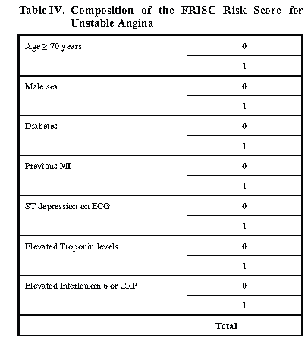

Slide 30
The FRISC score (2004) is based on the FRISC (Fast Revascularisation in Instability in Coronary disease) II trial.
c-statistic of the FRISC score for the prediction of death was 0.77 and for death/MI 0.70.
low, intermediate and high risk, based on the FRISC scores of 0-2, 3-4 and 5-7.
In one study conducted over 1200 patients, the high risk group mortality reduced from 15.4 – 5.2%, while the composite endpoint of death and MI was reduced in both intermediate and high risk groups.
The FRISC score is the only risk score that focussed on the treatment effect of early invasive strategies in ACS.
Investigators recommended early invasive strategies for patients with a FRISC score 3.
Risk Scores for Patients with Chest Pain: Evaluation in the EmergencyDepartment
B.E. Backus1,*, A.J. Six2, J.H. Kelder3, W.B. Gibler4, F.L. Moll1 and P.A. Doevendans1
Current Cardiology Reviews, 2011, 7, 2-8

Slide 31
Heart scoring
History | Highly suspicious | 2
 | Moderately suspicious | 1
 | Slightly suspicious | 0
ECG | Significant ST depression | 2
 | Non specific repolarization disturbance | 1
 | normal | 0
Age | ≥65 | 2
 | 46-64 | 1
 | ≤45 | 0
Risk factor | ≥3 risk facor or known atherosclerotic disease | 2
 | 1-2 risk factors | 1
 | No risk fctor known | 0
Troponin | ≥3x normal limit | 2
 | 1-3x normal limit | 1
 | ≤normal limit | 0
Low risk | 0-3 | 0.9%
Intermediate risk | 4-6 | 12%
High risk | 7-10 | 65%

Slide 32
the HEART risk score (2008) was developed for chest pain patients presenting to the ED
Investigator assessed endpoint of MI, Percutaneous Coronary Intervention (PCI), Coronary Artery Bypass Grafting (CABG) ordeath within 6 weeks after presentation.
The c-statistic was 0.90, indicating good toexcellent discriminative power.
The HEART score divides patients into low (0-3), intermediate (4-6) or high risk groups (7-10), with mean risks of an event of 0.9%, 12% and 65%, respectively
Risk Scores for Patients with Chest Pain: Evaluation in the EmergencyDepartment
B.E. Backus1,*, A.J. Six2, J.H. Kelder3, W.B. Gibler4, F.L. Moll1 and P.A. Doevendans1
Current Cardiology Reviews, 2011, 7, 2-8

Slide 33
TIMI, PURSUIT, and GRACE risk scores: sustained prognostic value and interaction with revascularization in NSTE‐ACS
Pedro de Araújo Gonçalves, Jorge Ferreira, Carlos Aguiar and
Ricardo Seabra-Gomes
Eur Heart J (May 2005) 26 (9):865-872.

Slide 34
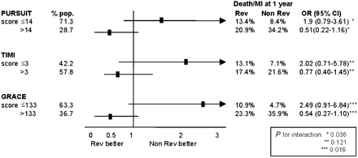
Interaction between the admission score and the prognostic impact of myocardial revascularization performed during initial hospital stay.
Eur Heart J (May 2005) 26 (9):865-872.

Slide 35
Comparison of the predictive accuracy of the risk scores
30 days |  | 1 year
 | Δ | P-value | Δ | P-value
PURSUIT vs. TIMI | 0.064 | 0.288 | 0.044 | 0.319
GRACE vs. PURSUIT | 0.057 | 0.332 | 0.086 | 0.04
GRACE vs. TIMI | 0.121 | 0.054 | 0.130 | 0.004
Eur Heart J (May 2005) 26 (9):865-872.

Slide 36
Conclusions
RSs developed from
Databases of clinical trials (PURSUIT and TIMI) or
Registries (GRACE)
At 30 days the risk stratification by all 3 scores for patients with NSTE‐ACS
has fair to good discriminatory accuracy
in predicting major adverse cardiac events
at both 30 days and 1 year.
The GRACE RS was the best for predicting the risk of death or MI at 1 year after admission.
Eur Heart J (May 2005) 26 (9):865-872.

Slide 37
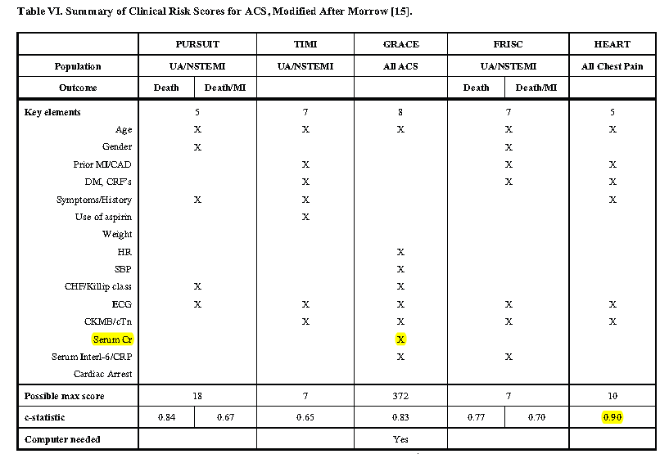
Risk Scores for Patients with Chest Pain: Evaluation in the EmergencyDepartment
B.E. Backus1,*, A.J. Six2, J.H. Kelder3, W.B. Gibler4, F.L. Moll1 and P.A. Doevendans1
Current Cardiology Reviews, 2011, 7, 2-8

Slide 38
A prospective validation of the HEART score for chest pain patients at the emergency department B.E. Backus et al International Journal of Cardiology 168 (2013) 2153–2158
Methods:
A total of 2440 unselected patients presented with chest pain at the cardiac emergency department of ten participating hospitals in The Netherlands. The HEART score was assessed as soon as the first lab results and ECG were obtained. Primary endpoint was the occurrence of major adverse cardiac events (MACE) within 6 weeks.

Slide 39
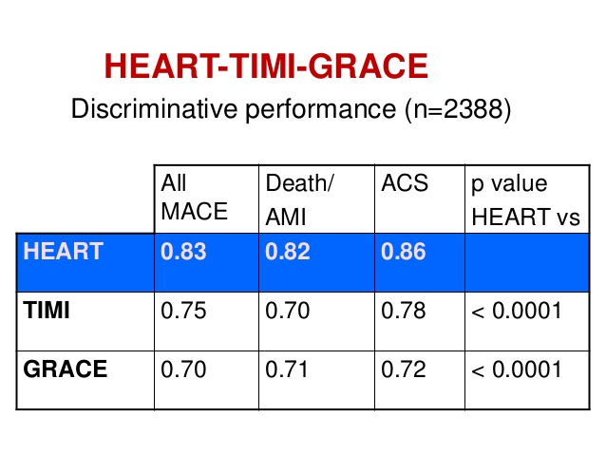

Slide 40
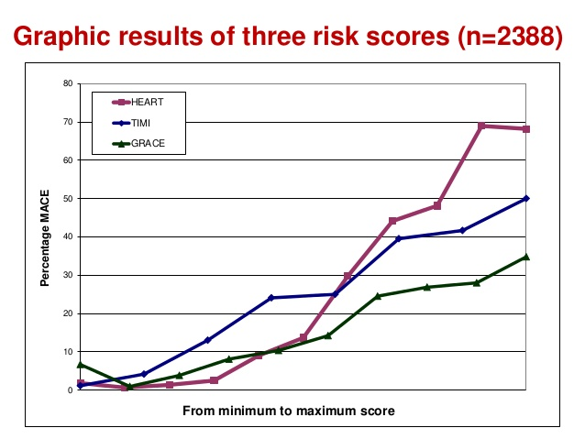

Slide 41
Conclusion:
The HEART score provides the clinician with a quick and reliable predictor of outcome, without computer-required calculating. Low HEART scores (0–3), exclude short-term MACE with >98% certainty. In these patients one might consider reserved policies. In patients with high HEART scores (7–10) the high risk of MACE may indicate more aggressive policies.

Slide 42
2014 AHA/ACC Guideline for the Management of Patients With Non–ST-Elevation Acute Coronary Syndromes: Executive Summary
A Report of the American College of Cardiology/American Heart Association Task Force on Practice Guidelines
Circulation. published online September 23, 2014

Slide 43
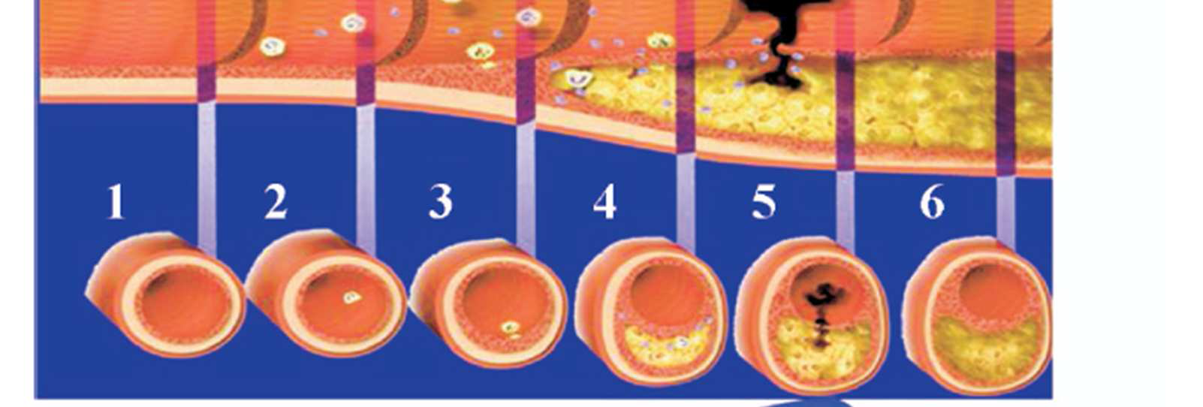

Slide 44
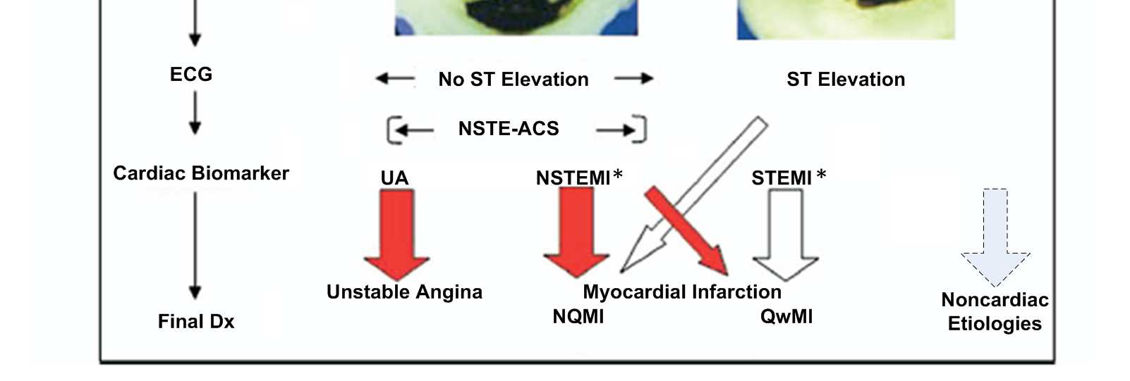

Slide 45
Initial Evaluation and Management

Slide 46
Emergency Department or Outpatient Facility Presentation
Patients with suspected ACS and high-risk features such as continuing chest pain, severe dyspnea, syncope/presyncope, or palpitations should be referred immediately to the ED and transported by EMS when available. (Class I; Level of Evidence C)

Slide 47
Prognosis: Early Risk Stratification
Perform rapid determination of likelihood of ACS, including a 12-lead ECG within 10 min of arrival at an emergency facility, in patients whose symptoms suggest ACS (Class I)
Perform serial ECGs at 15- to 30-min intervals during the first hour in symptomatic patients with initial nondiagnostic ECG (Class I)
Measure cardiac troponin (cTnI or cTnT) in all patients with symptoms consistent with ACS (Class I)
Measure serial cardiac troponin I or T at presentation and 3–6 h after symptom onset in all patients with symptoms consistent with ACS (Class I)

Slide 48
Prognosis: Early Risk Stratification
Use risk scores to assess prognosis in patients with NSTE-ACS (Class I)
Risk-stratification models can be useful in management (Class IIa)
Continuous monitoring with 12-lead ECG may be a reasonable alternative with initial non-diagnostic ECG in patients at intermediate/high risk for ACS (Class IIb)
BNP or NT–pro-BNP may be considered to assess risk in patients with suspected ACS (Class IIb)

Slide 49
Biomarkers: Diagnosis
Measure cardiac-specific troponin (troponin I or T) at presentation and 3─6 h after symptom onset in all patients with suspected ACS to identify pattern of values (Class I)
Obtain additional troponin levels beyond 6 h in patients with initial normal serial troponins with ECG changes and/or intermediate/high risk clinical features (Class I)
With contemporary troponin assays, CK-MB and myoglobin are not useful for diagnosis of ACS (Class III)

Slide 51
Discharge From the ED or Chest Pain Unit
Observe patients with symptoms consistent with ACS without objective evidence of myocardial ischemia (non-ischemic initial ECG and normal cardiac troponin) in a chest pain unit or telemetry unit with serial ECGs and cardiac troponin at 3- to 6-hour intervals (Class IIa)
Give low-risk patients who are referred for outpatient testing daily aspirin, short-acting NTG, and other medication if appropriate (e.g., beta blockers), with instructions about activity level and clinician follow-up (Class IIa)

Slide 52
Early Hospital Care

Slide 53
Standard Medical Therapies

Slide 54
Oxygen
Administer supplemental oxygen only with oxygen saturation <90%, respiratory distress, or other high-risk features for hypoxemia (Class I)

Slide 55
Nitrates
Administer sublingual NTG every 5 min × 3 for continuing ischemic pain and then assess need for IV NTG (Class I)
Administer IV NTG for persistent ischemia, HF, or hypertension (Class I)
Nitrates are contraindicated with recent use of a phosphodiesterase inhibitor (Class III)

Slide 56
Analgesic therapy
IV morphine may be reasonable for continued ischemic chest pain despite maximally tolerated anti-ischemic medications (Class IIb)
NSAIDs (except aspirin) should not be initiated and should be discontinued during hospitalization for NSTE-ACS because of the increased risk of MACE associated with their use (Class III)

Slide 57
Beta-adrenergic blockers
Initiate oral beta blockers within the first 24 h in the absence of HF, low-output state, risk for cardiogenic shock, or other contraindications to beta blockade (Class I)
Use of sustained-release metoprolol succinate, carvedilol, or bisoprolol is recommended for beta-blocker therapy with concomitant NSTE-ACS, stabilized HF, and reduced systolic function (Class I)
IV beta blockers are potentially harmful when risk factors for shock are present (Class III)

Slide 58
CCBs
Administer initial therapy with non-DHP CCBs with recurrent ischemia and contraindications to beta blockers in the absence of LV dysfunction, increased risk for cardiogenic shock, PR interval >0.24 s, or 2nd- or 3rd-degree AV block without a cardiac pacemaker (Class I)
Administer oral non-DHP CCBs with recurrent ischemia after use of beta-blocker and nitrates in the absence of contraindications (Class I)
CCBs are recommended for ischemic symptoms when beta-blockers are not successful, are contraindicated, or cause unacceptable side effects (Class I)
Immediate-release nifedipine is contraindicated in the absence of a beta-blocker (Class III)

Slide 59
Inhibitors of Renin-Angiotensin-Aldosterone System
ACE inhibitors should be started and continued indefinitely in all patients with LVEF < 0.40 and in those with hypertension, DM, or stable CKD, unless contraindicated (Class I)
ARB are recommended in patients with HF or MI with LVEF < 0.40 who are ACE inhibitor intolerant (Class I)

Slide 60
Initial Parenteral Anticoagulant Therapy in Patients With Definite NSTE-ACS

Slide 61
Aspirin
Non–enteric-coated aspirin (162 mg–325 mg) to all patients promptly after presentation and maintenance dose (81 mg/d–162 mg/d) continued indefinitely (Class I)

Slide 62
P2Y₁₂ inhibitors
In patients with NSTE-ACS who are unable to take aspirin because of hypersensitivity or major gastrointestinal intolerance, a loading dose of clopidogrel followed by a daily.
maintenance dose should be administeredP2Y₁₂ inhibitor in addition to aspirin should be administered for up to 12 mo to all patients with NSTE-ACS without contraindications who are treated with either an early invasive or ischemia-guided strategy (Class I)
Clopidogrel
300-mg or 600-mg loading dose, then 75 mg QD
Ticagrelor
180-mg loading dose, then 90 mg BID
P2Y₁₂ inhibitor therapy continued for at least 12 mo in post–PCI patients treated with coronary stents (Class I)
Ticagrelor in preference to clopidogrel for patients treated with an early invasive or ischemia-guided strategy (Class IIa)

Slide 63
GP IIb/IIIa inhibitors
GP IIb/IIIa inhibitor [Eptifibatide (Integrilin) or tirofiban (Aggrastat)] in patients treated with an early invasive strategy and dual anti-platelet therapy (DAPT) with intermediate/high-risk features (e.g., positive troponin) (Class IIb)

Slide 64
Parenteral anticoagulant and fibrinolytic therapy
SC enoxaparin for duration of hospitalization or until PCI is performed (Class I)
1 mg/kg SC Q12H (reduce dose to 1 mg/kg/d SC in patients with CrCl <30 mL/min)
Initial IV loading dose 30 mg
Bivalirudin until diagnostic angiography or PCI is performed in patients with early invasive strategy only (Class I)
Fondaparinux 2.5 mg SC QD for the duration of hospitalization or until PCI is performed (Class I)
IV UFH for 48 h or until PCI is performed (Class I)
Initial loading dose 60 IU/kg (max 4,000 IU) with initial infusion 12 IU/kg/h (max 1,000 IU/h)
Adjusted to therapeutic aPTT range
IV fibrinolytic treatment not recommended in patients with NSTE-ACS (Class III)

Slide 65
Summary of Recommendations for Initial Antiplatelet/Anticoagulant Therapy in Patients With Definite or Likely NSTE-ACS and PCI

Slide 67
Ischemia-Guided Strategy Versus Early Invasive Strategies

Slide 68
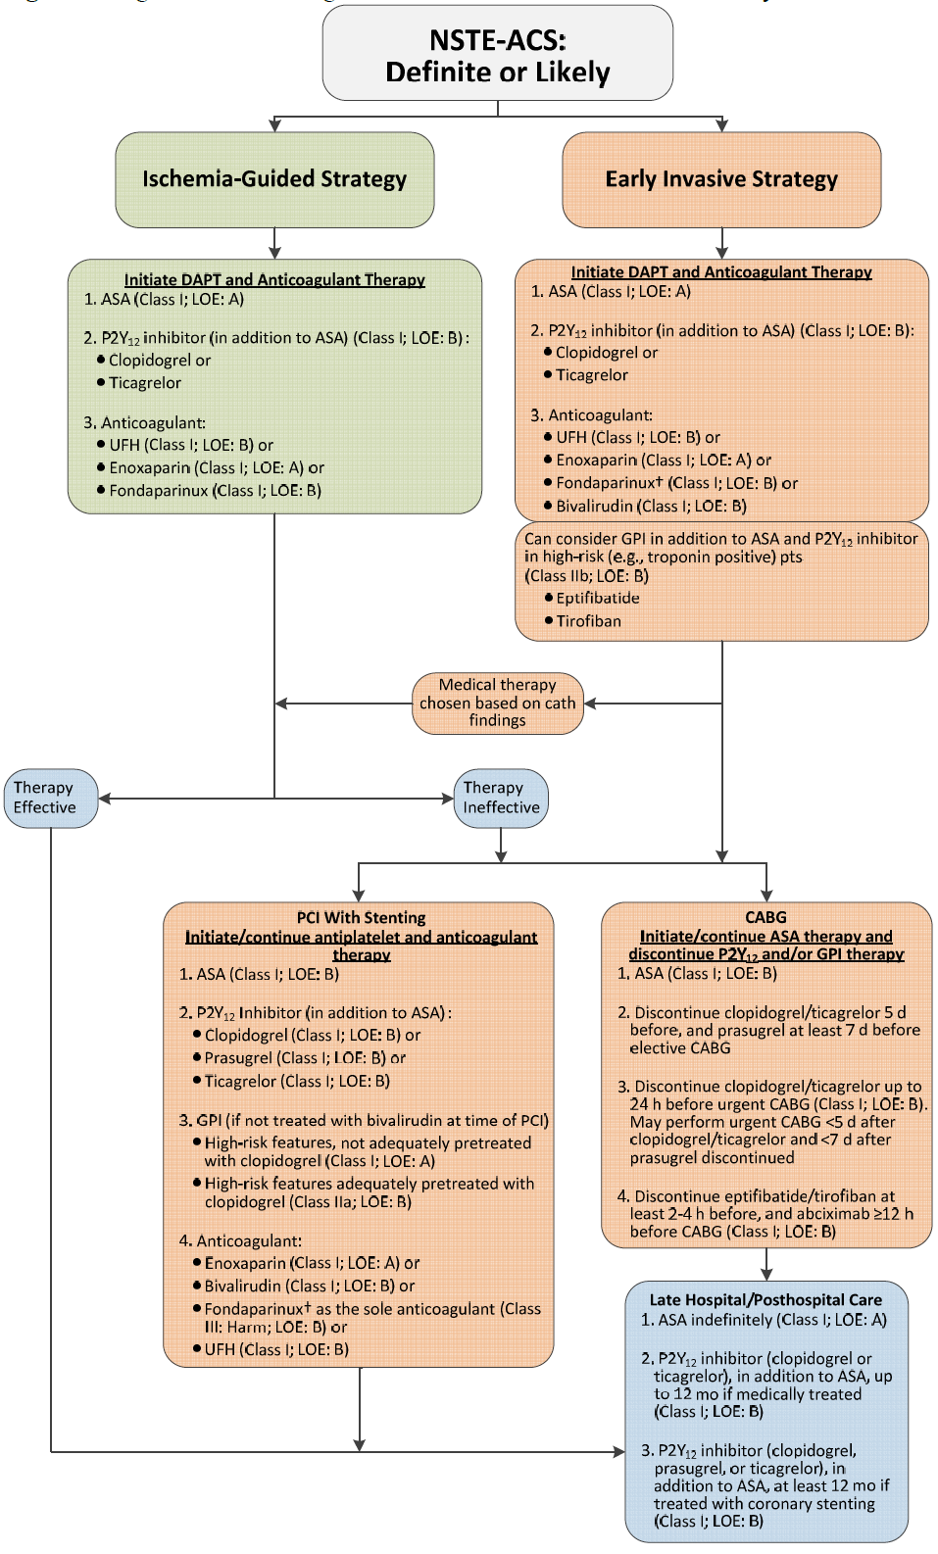

Slide 69
Early Invasive and Ischemia-Guided Strategies

Slide 72
Risk Stratification Before Discharge for Patients With an Ischemia-Guided Strategy of NSTE-ACS: Recommendations
CLASS I
Noninvasive stress testing is recommended in low- and intermediate-risk patients who have been free of ischemia at rest or with low-level activity for a minimum of 12 to 24 hours.
Treadmill exercise testing is useful in patients able to exercisem in whom the ECG is free of resting ST changes that may interfere with interpretation.

Slide 73
Stress testing with an imaging modality should be used in patients who are able to exercise but have ST changes on resting ECG that may interfere with interpretation. In patients undergoing a low-level exercise test, an imaging modality can add prognostic information.
Pharmacological stress testing with imaging is recommended when physical limitations preclude adequate exercise stress.
A noninvasive imaging test is recommended to evaluate LV function in patients with definite ACS.

Slide 74
PCI—General Considerations: Recommendation
CLASS 2B
A strategy of multivessel PCI, in contrast to culprit lesion only PCI, may be reasonable in patients undergoing coronary revascularization as part of treatment for NSTEACS

Slide 75
PCI-Oral and Intravenous Antiplatelet Agents: Recommendations
CLASS I
Patients already taking daily aspirin before PCI should take 81 mg to 325 mg non–enteric-coated aspirin before PCI.
Patients not on aspirin therapy should be given non–enteric coated aspirin 325 mg as soon as possible before PCI.
After PCI, aspirin should be continued indefinitely at a dose of 81 mg to 325 mg daily.

Slide 76
CLASS 1
A loading dose of a P2Y12 receptor inhibitor should be given before the procedure in patients undergoing PCI with stenting
Options include:
a. Clopidogrel: 600 mg
b. Prasugrel: 60 mg
c. Ticagrelol: 180 mg
In patients with NSTE-ACS and high-risk features (e.g., elevated troponin) not adequately pretreated with clopidogrel or ticagrelor, it is useful to administer a GP IIb/IIIa inhibitor (abciximab, double-bolus eptifibatide, or high-dose bolus tirofiban) at the time of PCI (

Slide 77
In patients receiving a stent (bare-metal stent or drugeluting stent [DES]) during PCI for NSTE-ACS, P2Y12 inhibitor therapy should be given for at least 12 months.
Options include:
a. Clopidogrel: 75 mg daily
b. Prasugrel: 10 mg daily
c. Ticagrelol: 90 mg twice daily

Slide 78
CLASS IIa
It is reasonable to choose ticagrelor over clopidogrel for P2Y12 inhibition treatment in patients with NSTE-ACStreated with an early invasive strategy and/or coronary stenting.
It is reasonable to choose prasugrel over clopidogrel for P2Y12 treatment in patients with NSTE-ACS who undergo PCI who are not at high risk of bleeding complications.
In patients with NSTE-ACS and high-risk features (e.g., elevated troponin) treated with UFH and adequately pretreated with clopidogrel, it is reasonable to administer a GP IIb/IIIa inhibitor (abciximab, double-bolus eptifibatide, or high-bolus dose tirofiban) at the time of PCI

Slide 79
After PCI, it is reasonable to use 81 mg per day of aspirin in preference to higher maintenance doses.
If the risk of morbidity from bleeding outweighs the anticipated benefit of a recommended duration of P2Y12 inhibitor therapy after stent implantation, earlier discontinuation (e.g., <12 months) of P2Y12 inhibitor therapy is reasonable.

Slide 80
CLASS IIb
Continuation of DAPT beyond 12 months may be considered in patients undergoing stent implantation.
CLASS III: HARM
Prasugrel should not be administered to patients with a prior history of stroke or transient ischemic attack.

Slide 81
Timing of Urgent CABG in Patients With NSTE-ACS in Relation to Use of Antiplatelet Agents: Recommendations
CLASS I
Non–enteric-coated aspirin (81 mg to 325 mg daily) should be administered preoperatively to patients undergoing CABG.
In patients referred for elective CABG, clopidogrel and ticagrelor should be discontinued for at least 5 days before surgery (Level of Evidence: B) and prasugrel for at least 7 days before surgery
In patients referred for urgent CABG, clopidogrel and ticagrelor should be discontinued for at least 24 hours to reduce major bleeding

Slide 82
In patients referred for CABG, short-acting intravenous GPnIIb/IIIa inhibitors (eptifibatide or tirofiban) should be discontinued for at least 2 to 4 hours before surgery and abciximab for at least 12 hours before to limit blood loss and transfusion
CLASS 2B
In patients referred for urgent CABG, it may be reasonable to perform surgery less than 5 days after clopidogrel or ticagrelor has been discontinued and less than 7 days after prasugrel has been discontinued

Slide 83
LATE HOSPITAL CARE, HOSPITAL DISCHARGE, AND POSTHOSPITAL DISCHARGE CARE
CLASS I
Medications required in the hospital to control ischemia should be continued after hospital discharge in patients with NSTE-ACS who do not undergo coronary revascularization, patients with incomplete or unsuccessful revascularization and patients with recurrent symptoms after revascularization. Titration of the doses may be required.
All patients who are post–NSTE-ACS should be given sublingual or spray nitroglycerin with verbal and written instructions for its use.

Slide 84
Before hospital discharge, patients with NSTE-ACS should be informed about symptoms of worsening myocardial ischemia and MI and should be given verbal and written instructions about how and when to seek emergency care for such symptoms.
Before hospital discharge, patients who are post–NSTE-ACS and/or designated responsible caregivers should be provided with easily understood and culturally sensitive verbal and written instructions about medication type, purpose, dose, frequency, side effects, and duration of use.

Slide 85
For patients who are post–NSTE-ACS and have initial angina lasting more than 1 minute, nitroglycerin (1 dose sublingual or spray) is recommended if angina does not subside within 3 to 5 minutes; call 9-1-1 immediately to access emergency medical services.
If the pattern or severity of angina changes, suggesting worsening myocardial ischemia (e.g., pain is more frequent or severe or is precipitated by less effort or occurs at rest), patients should contact their clinician without delay to assess the need for additional treatment or testing.
Before discharge, patients should be educated about modification of cardiovascular risk factors

Slide 86
Late Hospital and Posthospital Oral Antiplatelet Therapy: Recommendations
CLASS I
Aspirin should be continued indefinitely. The maintenance dose should be 81 mg daily in patients treated with ticagrelor and 81 mg to 325 mg daily in all other patients.
In addition to aspirin, a P2Y12 inhibitor (either clopidogrel or ticagrelor) should be continued for up to 12 months in all patients with NSTE-ACS without contraindications who are treated with an ischemia-guided strategy.
Options include: Clopidogrel: 75mg daily
Ticagrelor: 90 mg twice daily

Slide 87
In patients receiving a stent (bare-metal stent or DES) during PCI for NSTE-ACS, P2Y12 inhibitor therapy should be given for at least 12 months . Options include:
Clopidogrel: 75 mg daily
Prasugrel: 10 mg daily
Ticagrelor: 90mg twice daily

Slide 88
Special population

Slide 94
Clinical Presentation
Anginal pain in NSTE-ACS patients may have the following presentations:
Prolonged (.20 min) anginal pain at rest;
New onset (de novo) angina (class II or III of the Canadian Cardiovascular Society classification);
Recent destabilization of previously stable angina with at least Canadian Cardiovascular Society Class III angina characteristics (crescendo angina); or
Post-MI angina.

Slide 95
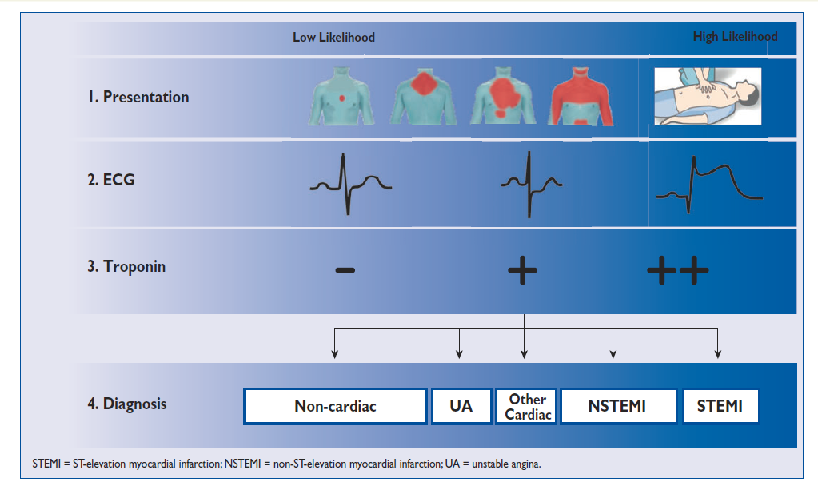
Diagnosis

Slide 96
0 h/3 h rule-out algorithm of non-ST-elevation acute coronary syndromes using high-sensitivity cardiac troponin assays

Slide 97
New: 0 h/1 h rule-in & rule-out algorithm of non-ST-elevation acute coronary syndromes using high-sensitivity cardiac troponin assays

Slide 98
Recommendations

Slide 100
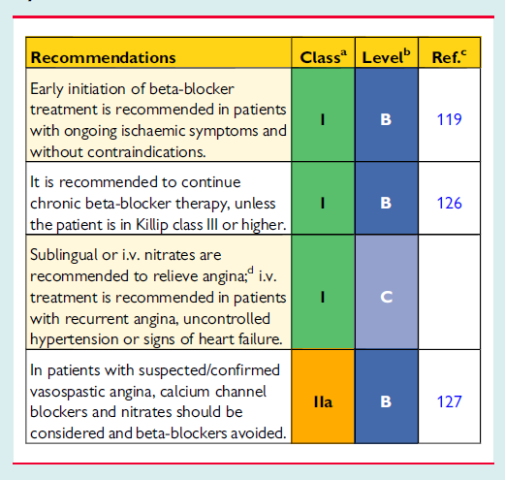
Recommendations for anti-ischaemic drugs in the acute phase

Slide 101
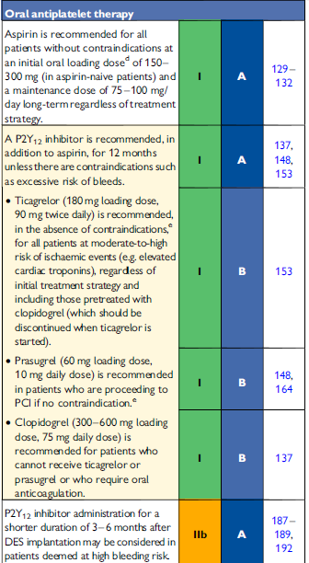
Recommendations in DAPT

Slide 102
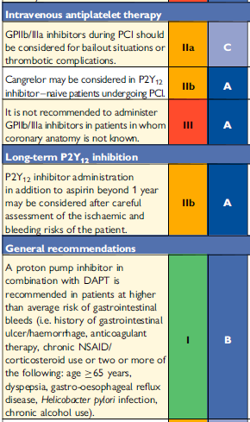
Recommendations in DAPT
NEW

Slide 103
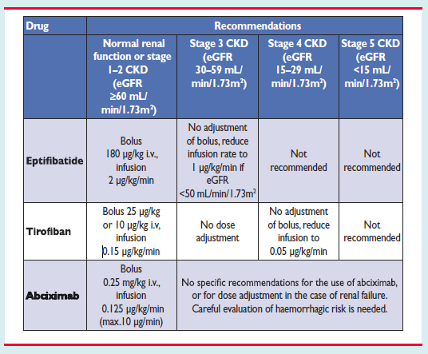
Dosing of glycoprotein IIb/IIIa inhibitors in patients with normal and impaired renal function

Slide 104
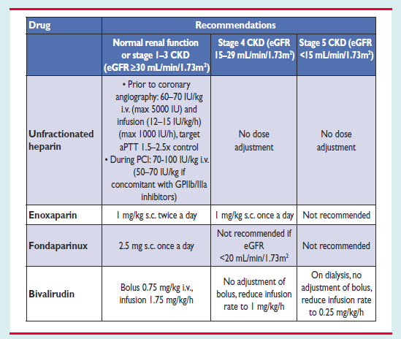
Dosing of anticoagulants in patients with normal and impaired renal function

Slide 105
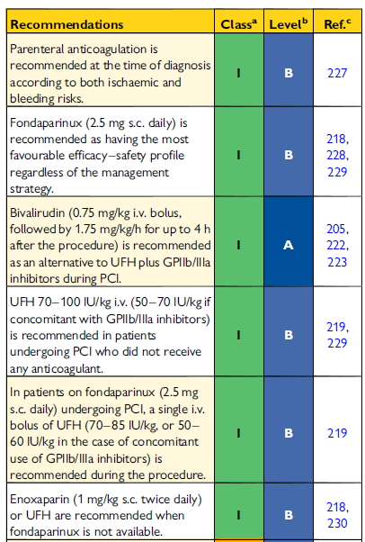
Recommendations for anticoagulation
NEW

Slide 106
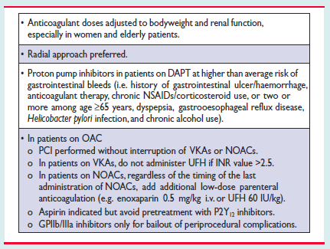
Suggested strategies to reduce bleeding risk related to PCI
NEW

Slide 107
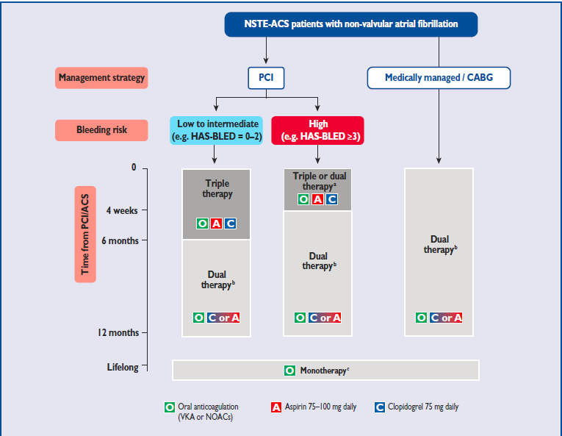
Antithrombotic strategies in patients with NSTEMI and non-valvular A. Fib

Slide 108
Recommendations for combining antiplatelet agents and anticoagulants in NSTEMI patients requiring chronic oral anticoagulation

Slide 109
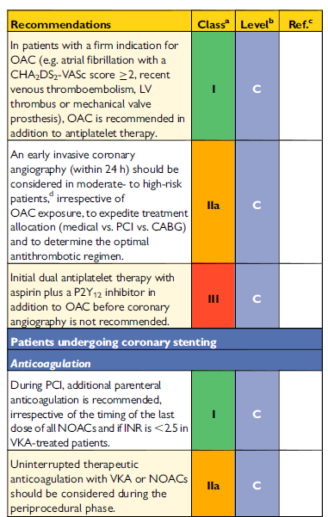

Slide 110
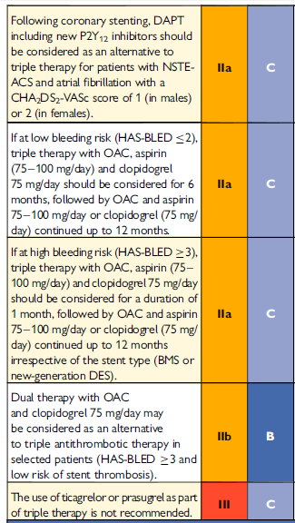

Slide 111
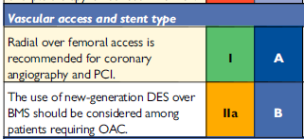

Slide 112
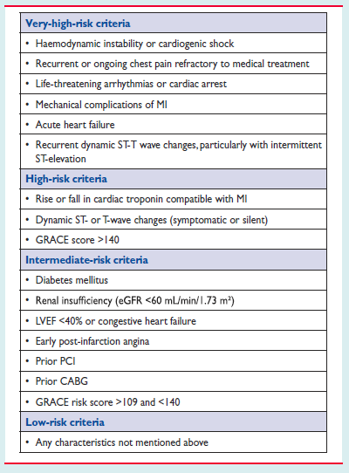
Risk criteria mandating invasive strategy in NSTE-ACS

Slide 113
Selection of treatment strategy and timing according to initial risk stratification.

Slide 114
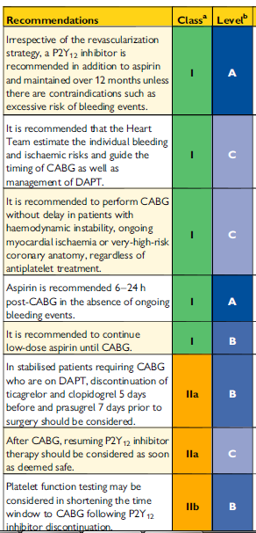
Recommendations for perioperative management of antiplatelet therapy patients requiring CABG

Slide 115
Recommendations for invasive coronary angiography and revascularization

Slide 116
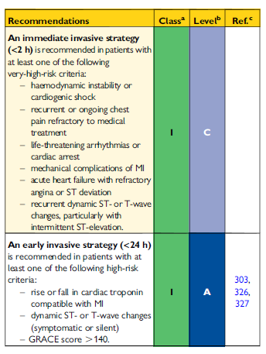

Slide 117
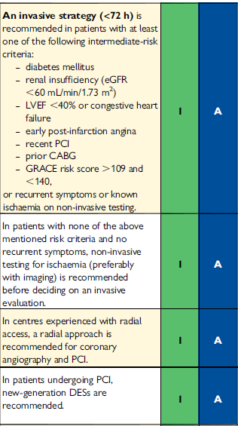

Slide 118
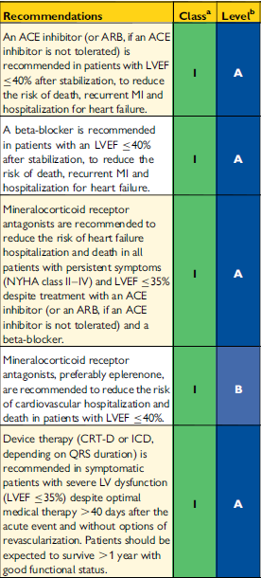
Recommendations for the management of patients with heart failure NSTEMI

Slide 119
Recommendations for long-term management after non-ST-elevation acute coronary syndromes

Slide 120
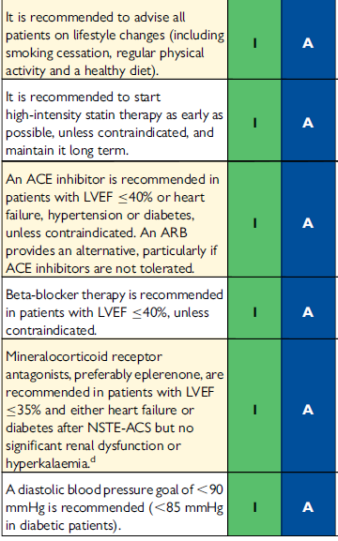

Slide 121
To do and not to do messages
from the guidelines

Slide 122
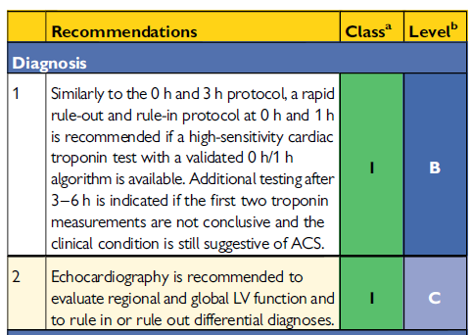

Slide 123
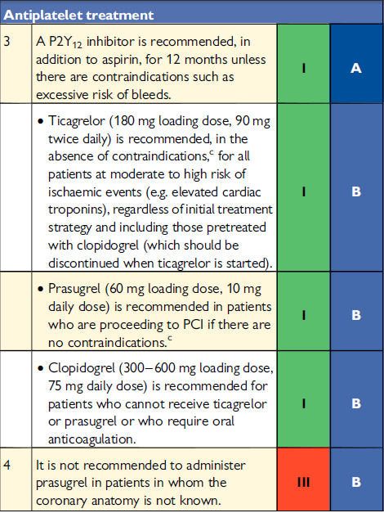

Slide 124
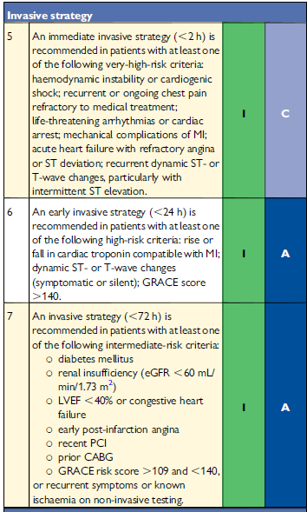

Slide 125
